Slide 1

Step 1: Click the Restore Down Button.

Slide 2
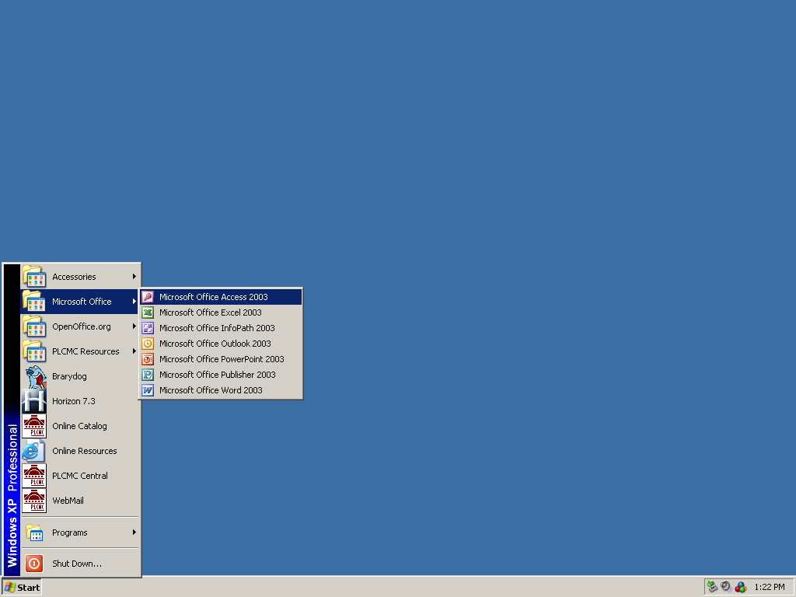
Step 2: Click START.
Step 3: Click MICROSOFT OFFICE.
Step 4: Click MICROSOFT OFFICE ACCESS 2003.

Slide 3
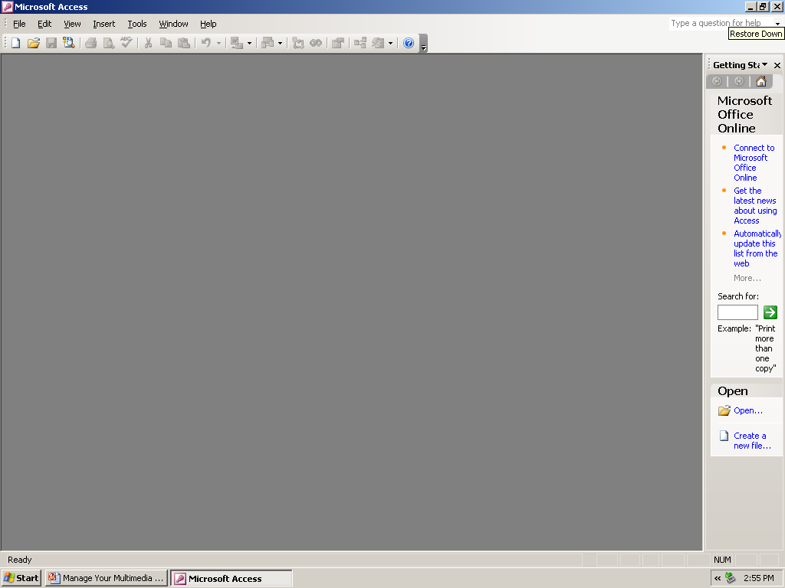
Step 5: Click the Restore Down Button.

Slide 4
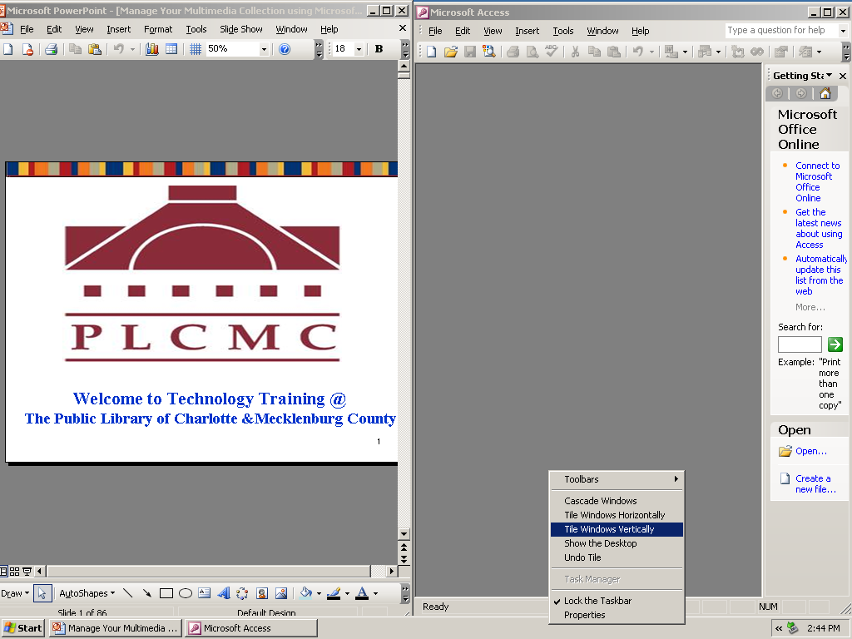
To view both windows on the same screen:
Step 6: Right-Click on the Taskbar.
Step 7: Click “Tile Windows Vertically”

